Slide 1

Probability of default estimation
Implementacja modeli finansowych ex. 4
Notes:
Norbert

Slide 2
Agenda
Dataset analysis and preprocessing
Discussing the problems and proposing solutions
Method 1
Method 2
Additional approach
Notes:
Norbert

Slide 3

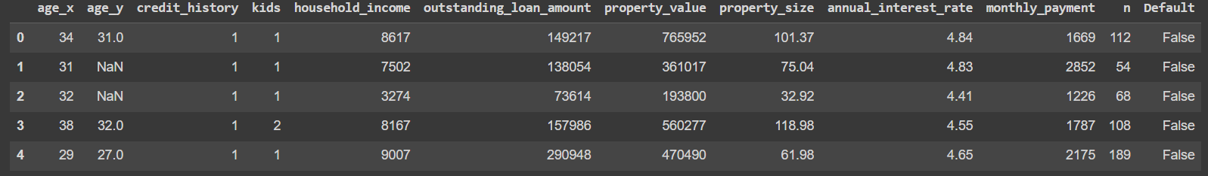
Data analysis
Dataset has 8543 rows and 12 columns which describes basic information about borrowers that we see below. In the last column there is information about default of a client.
Our aim is to create models which predict the probability of mentioned default.
Notes:
Norbert

Slide 4
Discussing the problems
Notes:
Norbert

Slide 5
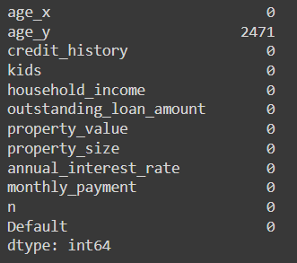
1.
Missing values
There are 2,471 (almost 30%) missing values in the age_y column. Probably, the age columns tell us the age of the people taking out the loan. If there is a missing value in the age_y column, it means that the loan was taken out by a single person.
Suggested solution:
Create two models, one for individuals and another for pairs.
Replace these two variables with new ones: the average age and a binary variable indicating whether the loan was taken out by one person or two.
Notes:
Daria

Slide 6
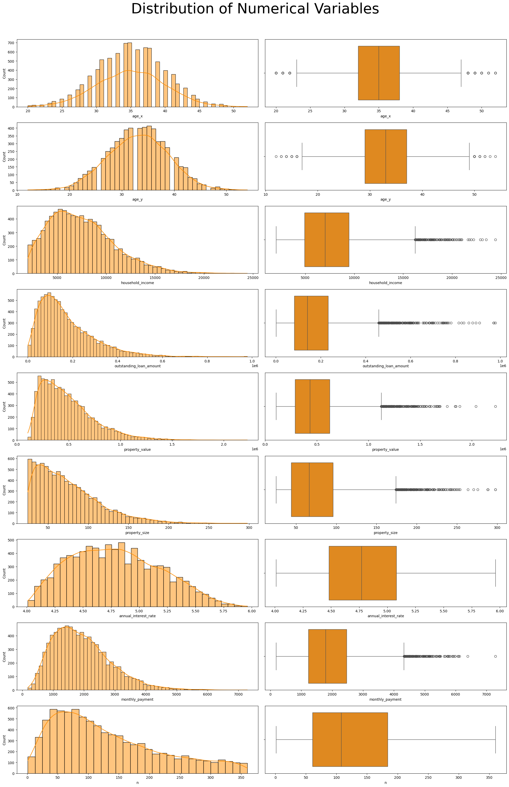
2.
Weird values in age_y
There are unrealistic values in the age_y column. The smallest value in this variable is 12.
Suggested solution:
We assume that a person under the age of 18 cannot obtain a loan. We replace all such records with NaN. This will slightly increase the number of missing values, but we will not lose any rows.
Notes:
Daria

Slide 7
3.
Age_x
Outliers in columns
Certain columns contain values that can be identified as outliers.
Suggested solution:
These values reflect real-world data. Therefore, we will retain them in the dataset to ensure that our model accurately represents all possible cases and maintains its robustness in handling diverse data points.
Age_y
Household income
Outstanding loan ammount
Property value
Property size
Annual interest rate
Monthly payment
n
Notes:
Daria

Slide 8
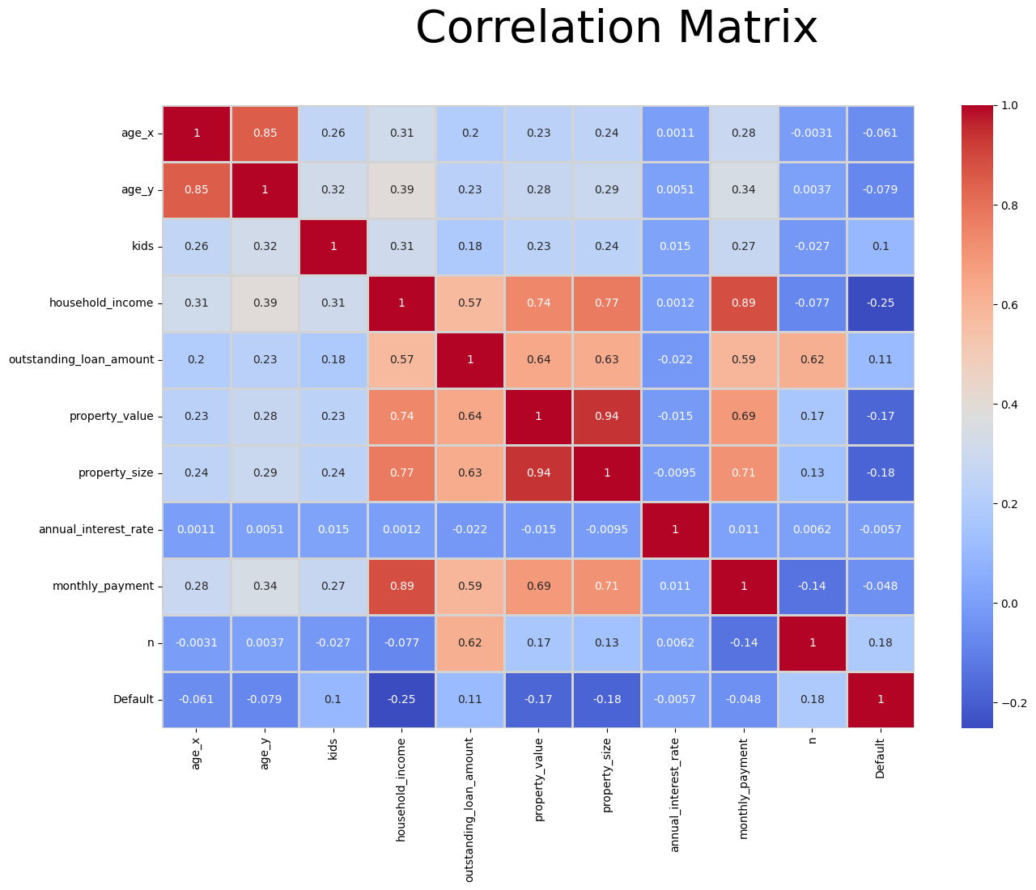
4.
Colinearity of variables and suggested solutions:
age x and age y – solution to this problem has already been adressed in previous slides.
property value and property size – we will divide the property value by size to obtain the value per square meter.
monthly payment and household income – we will remove monthly payment because it has a lower correlation with default than household income.
Additionally, we assume that a correlation below 0.8 will not impact the model negatively.
Notes:
Daria

Slide 9
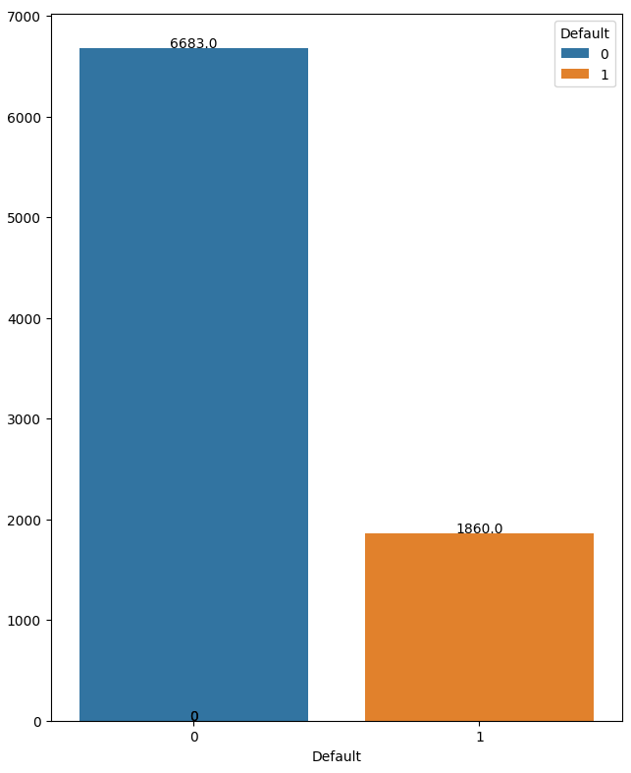
5.
Class Imbalance in the default Column
There is a notable class imbalance observed in the default column.
Suggested Solution:
To address this issue, we opt to implement upsampling to increase the representation of defaults (class 1).
Notes:
Daria

Slide 10


Methodology
Two approaches of creating a model estimating the probability of default:
Method 1: the dataset is divided into two sets - one where the age_y takes numerical values and another where we remove this column.
Method 2: age_x and age_y are transformed into two columns - one containing the average age of two and another indicating whether the loan was taken individually.
For each approach:
Standard Scaler is applied to standardize the data.
Dataset is split into training and test sets.
Chosen algorithms: Logistic Regression and Decision Tree. Hyperparameters adjustments is done by validation curves and grid search.
Notes:
BArtek

Slide 11
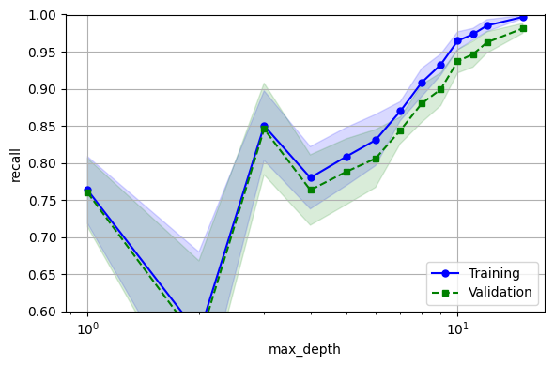
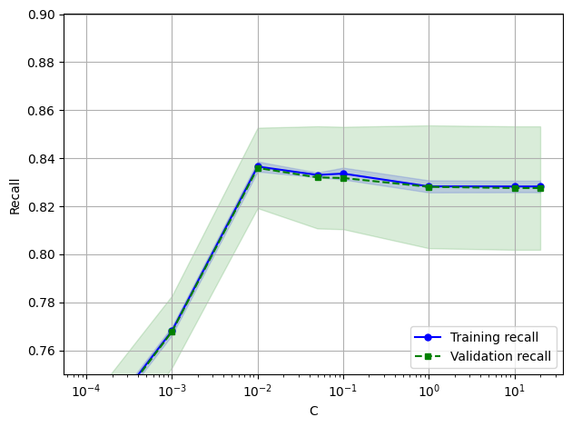

Choosing hyperparameters for models
After training the baseline models, we additionally used the grid search method to select hyperparameters that yield the best results across various metrics.
Notes:
Bartek

Slide 12

Results
Method | Model | Accuracy | Recall | AUC
Shared | Logistic regression | 0.788 | 0.827 | 0.875
 | Decision tree | 0.735 | 0.667 | 0.740
Individual | Logistic regression | 0.778 | 0.769 | 0.880
 | Decision tree | 0.749 | 0.573 | 0.71
Method 2 | Logistic regression | 0.785 | 0.836 | 0.878
 | Decision tree | 0.718 | 0.702 | 0.76
In each case, the decision tree algorithm produced worse results than Logistic Regression. Method 2 yielded very similar results to the model for shared credit from method 1. However, the model for individual credit performed significantly worse. Therefore, we decide that Logistic Regression from method 2 is the most suitable model.
Notes:
Bartek

Slide 13
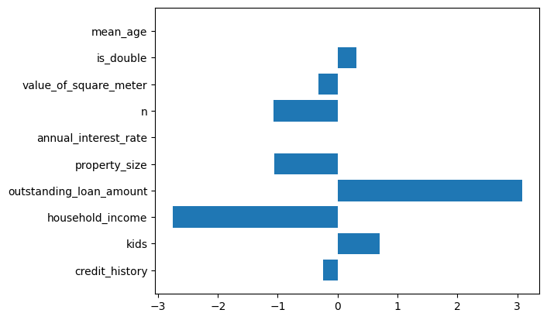
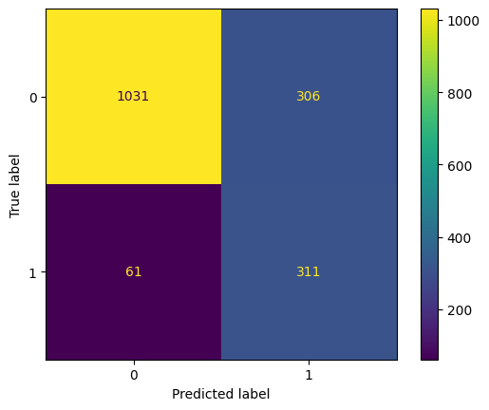
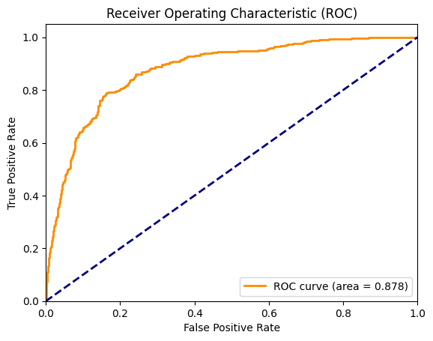
Notes:
Bartek

Slide 14

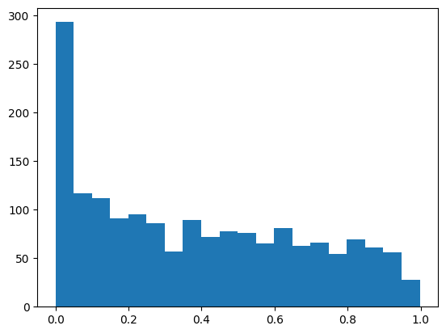
Example
For the shared credit : Average age: 40.5 years, Number of loans: 2, Number of children: 2, Income: $8600, Outstanding loan amount: $19731, Property size: 68.32 m², Annual interest rate: 4.42%, n: 8, Value of square meter: $6314. Probability of default (PD): 2.59%. No bankruptcy occurred.
For the individual credit: Age: 37 years, Number of loans: 1, Number of children: 1, Income: $2314, Outstanding loan amount: $205771, Property size: 49.36 m², Annual interest rate: 4.35%, n: 329, Value of square meter: $6227. Probability of default (PD): 86.7%. Bankruptcy occurred.
Notes:
Bartek

Slide 15
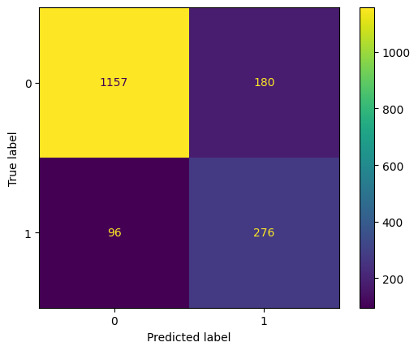
Additional approach
Moreover, we implemented XGBoost for the selected model. This algorithm is not preferred by financial institutions due to its lack of interpretability and clarity. Nonetheless, we checked if we could achieve better results using it.
Method | Model | Accuracy | Recall | AUC
Method 2 | Logistic regression | 0.785 | 0.836 | 0.878
 | Decision tree | 0.718 | 0.702 | 0.76
 | XGBoost | 0.839 | 0.742 | 0.9
Notes:
Norbert

Slide 16

Additional approach 2
We also tried a model in which we removed outliers (which we had retained in the baseline model). Additionally, instead of performing upsampling, we used the built-in class balancing method for the algorithms. Unfortunately, this approach yielded significantly worse results.
Therefore, we decided not to use it.
Notes:
Norbert

Slide 17

Thank you!
Daria Wielgosz
Bartłomiej Szymczyk
Norbert Lużyński
Notes:
Wszyscy

